Slide 1
PostgreSQL in Korea
Hyungjoo Lee (leehj@bitnine.net)
Korea Postgres User Group
Feb 4. 2016, PgConf, Moscow

Slide 2
AGENDA
PostgreSQL in Korea
1. About our company
1
2. How does the PG is enabled in Korea
4
3. PostgreSQL Community in Korea
5
4. What we are doing
7

Slide 3
PostgreSQL in Korea
1. About our company
Agens Solutions
Agens SQL
Agens SQL is an open-source RDBMS based on PostgreSQL 9.4
This solution is packaged with some modules for HA, migration…
We provide technical support for operating of Agens SQL
Agens Manager
Agens Manager is a admin tool for Agens SQL
This tool will be support the various functions about the visualization for Agens Graph and launched at September in this year
Agens Graph
Agens Graph is a multi model database based on PostgreSQL
The solution will be launched at September with Agens Manager
1

Slide 4
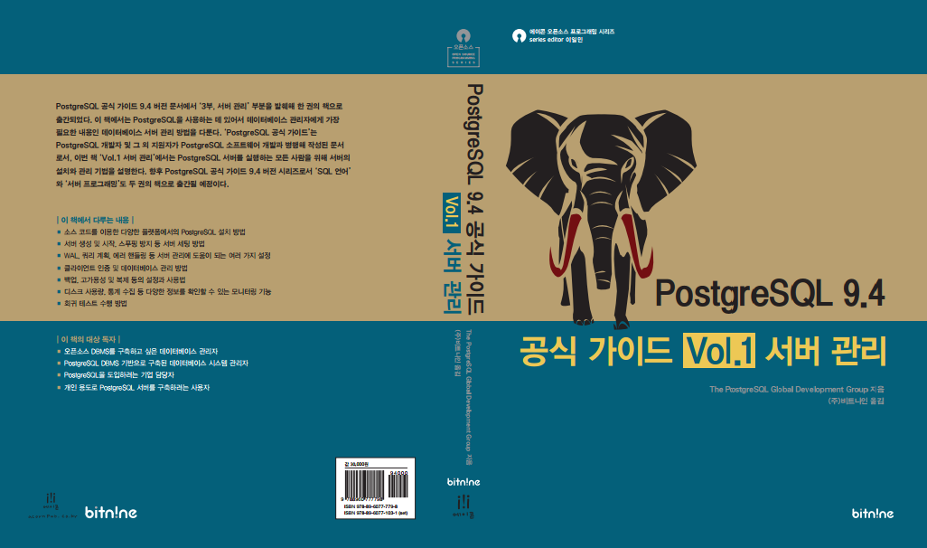
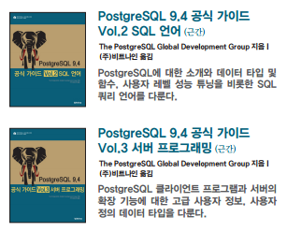
PostgreSQL in Korea
1. About our company
Contributions
Publication
The book, Vol.1(Part III, Server Administration), was published the last November
Vol.2(Part I ~ II, Tutorial and The SQL Language) will be published at March in this year
2

Slide 5
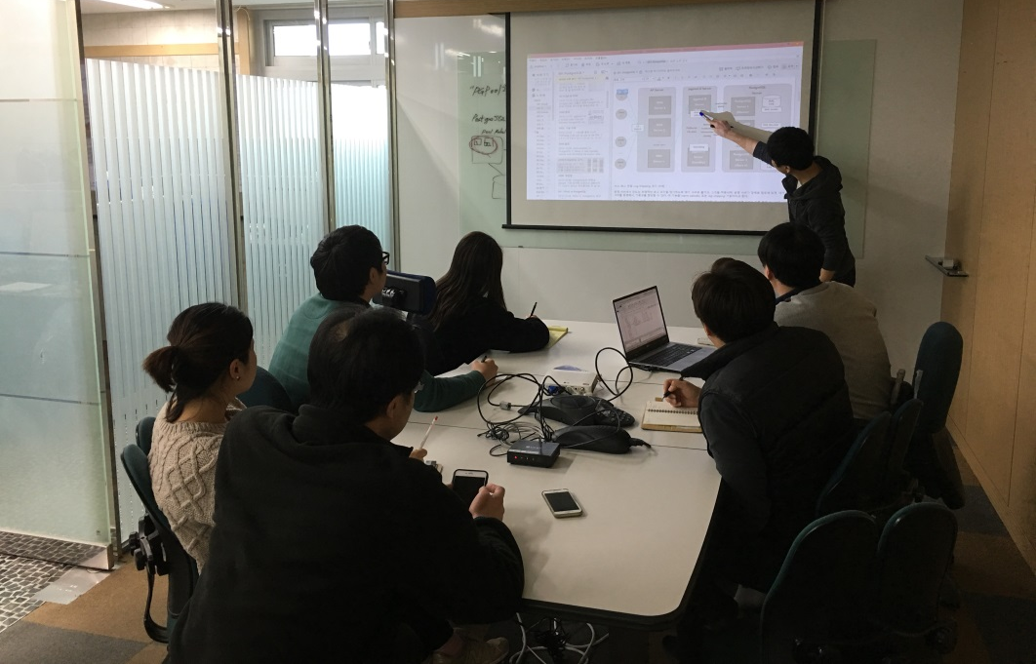
PostgreSQL in Korea
1. About our company
Contributions
Translation
PostgreSQL Message
The Korean boxes will be green
Education and Seminar
We have a professional team for the PostgreSQL education
The technical seminars
3

Slide 6
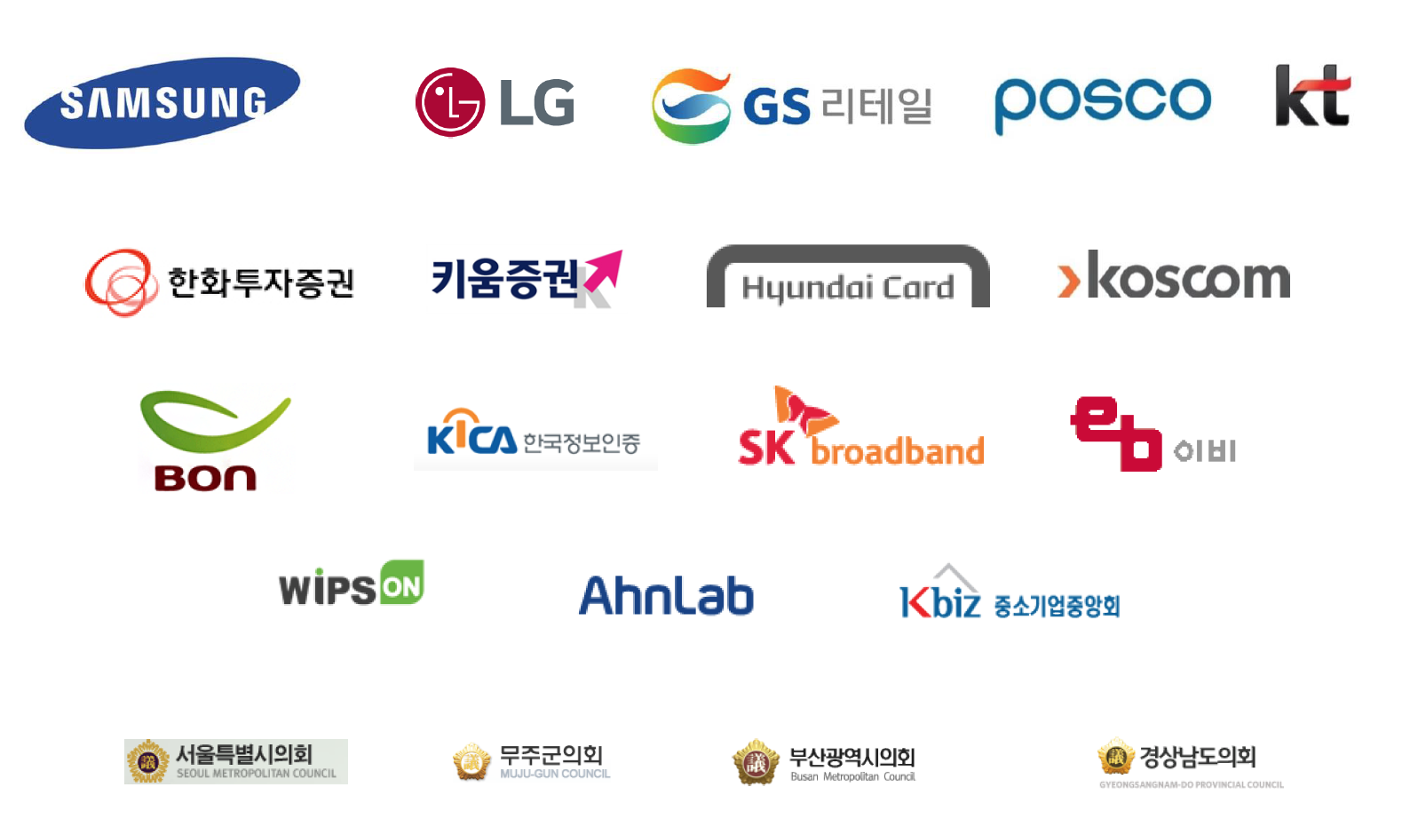
PostgreSQL in Korea
2. How does the PostgreSQL is enabled in Korea
Examples of Introduction
4

Slide 7
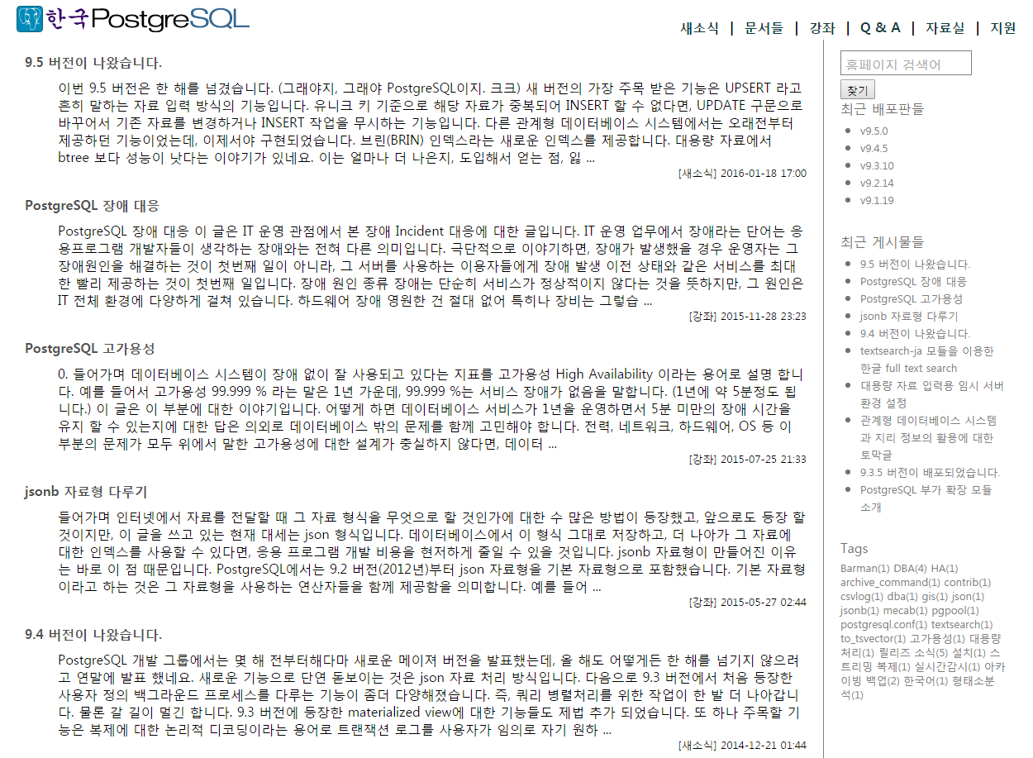
PostgreSQL in Korea
2. How does the PostgreSQL is enabled in Korea
Here is the official Korea site in International Sites section of PG
2016. 01.
2015. 11.
2015. 07.
2015. 05.
2014. 12.
5

Slide 8
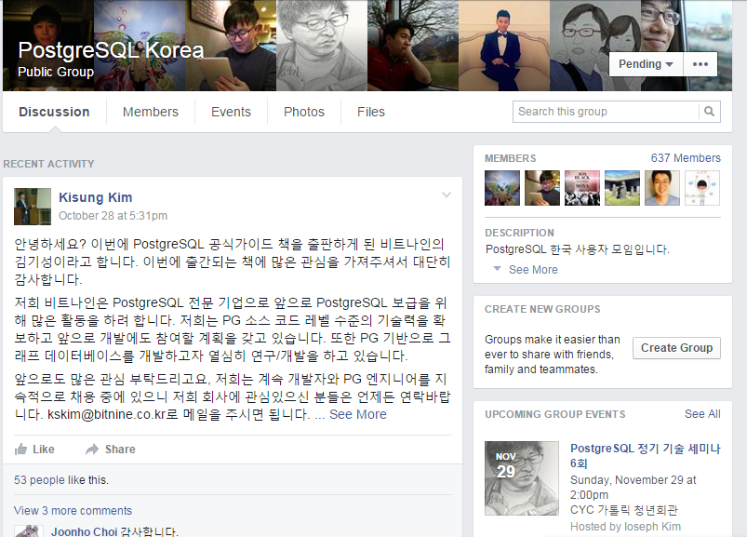
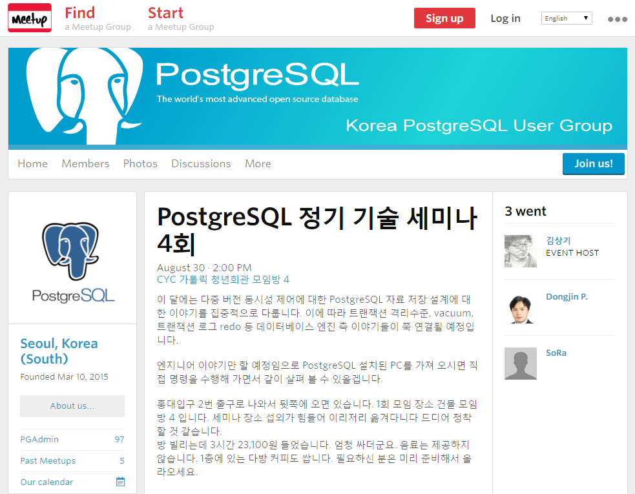
PostgreSQL in Korea
3. PostgreSQL Communities in Korea
Facebook Group
Meetup
6

Slide 9
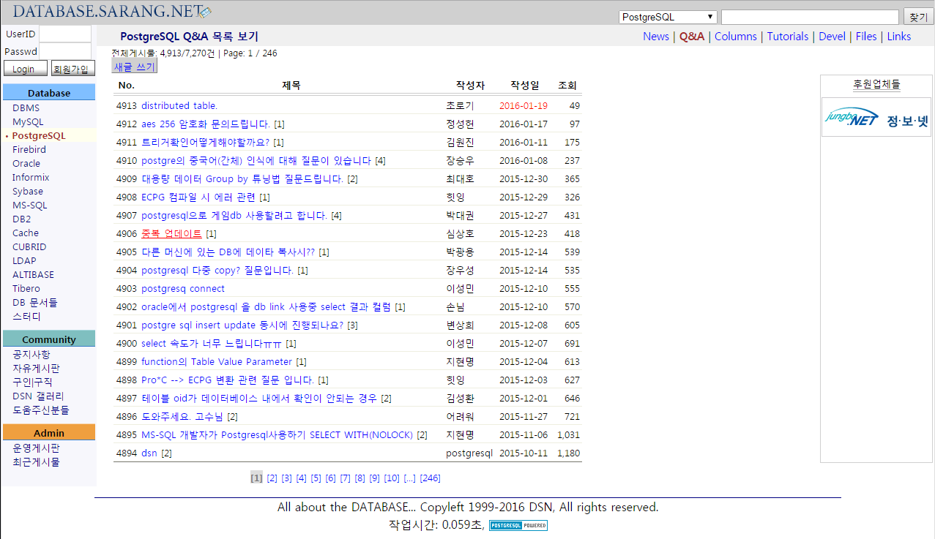
PostgreSQL in Korea
3. PostgreSQL Communities in Korea
database.sarang.net
7

Slide 10
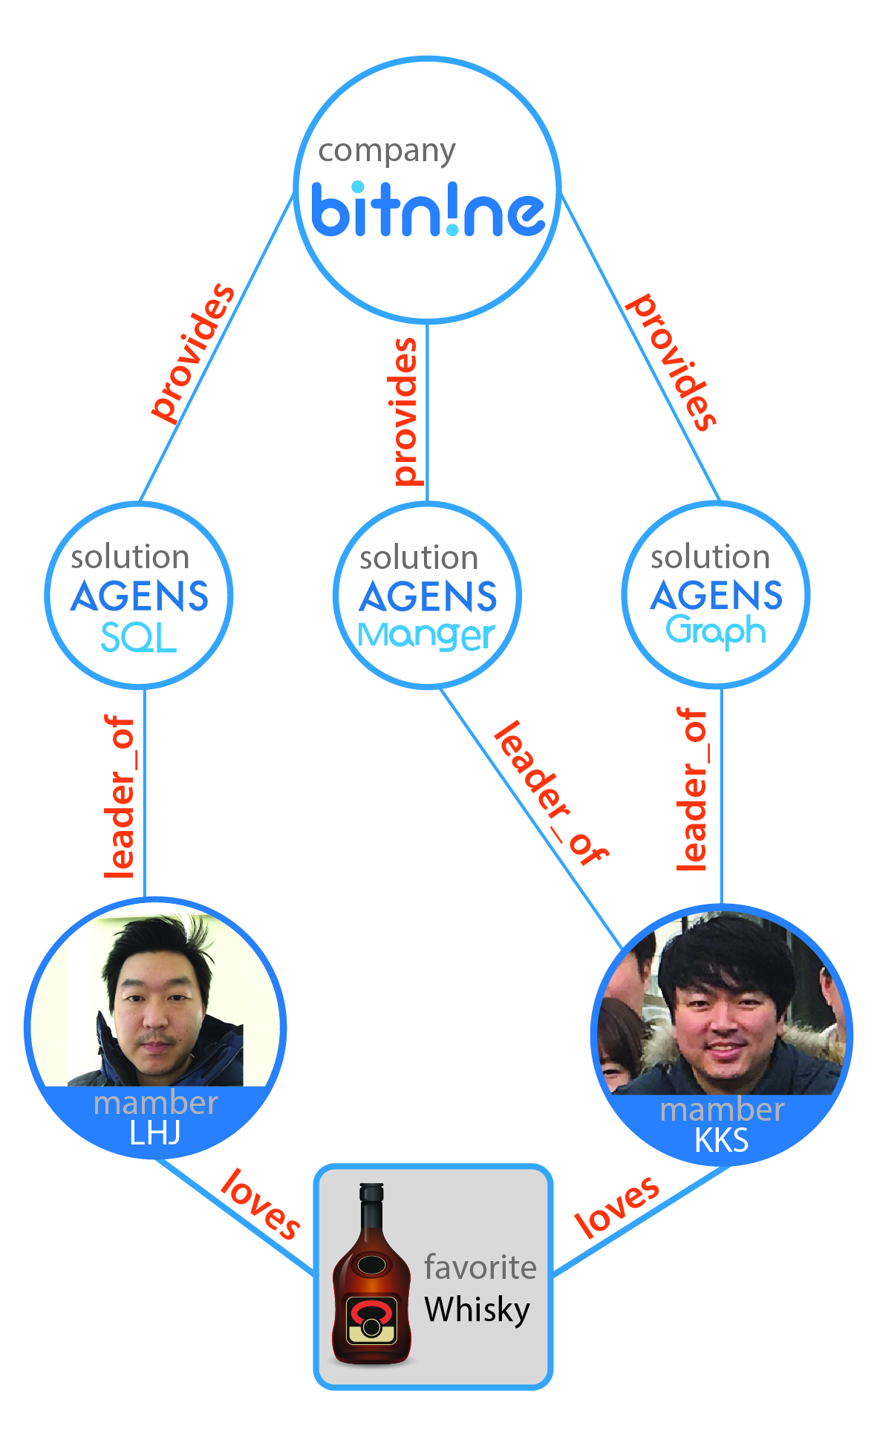
PostgreSQL in Korea
4. What we are doing by using PG
What is Graph Database?
Data is linked with each other
Processing big connected data is really challenging
In RDB, one step along an edge needs a join operation
We need specialized DB for processing connected data
Graph database
Specializing database for connected data
Connections is first-class citizen in graph database
Use graph data model not relational model
Graph data model is much easier than relational model
Explicitly express connection between data
Intuitive data model
No need to relational data modeling (denormalization/normalization)
No need to specify joins in queries
8

Slide 11
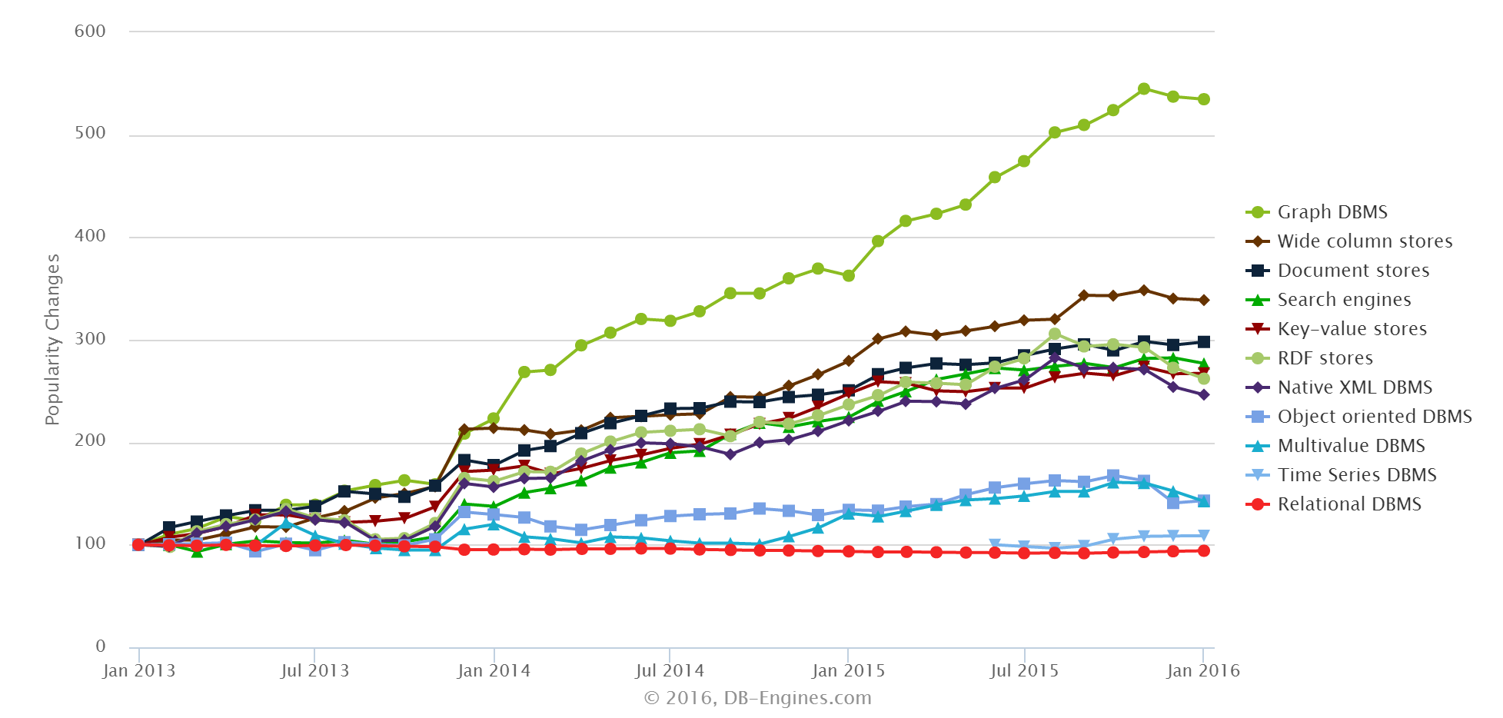
PostgreSQL in Korea
4. What we are doing by using PG
Graph Solution Landscape
9

Slide 12
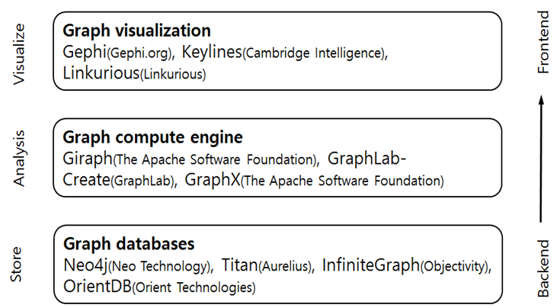
PostgreSQL in Korea
4. What we are doing by using PG
Graph Solution Landscape
10

Slide 13
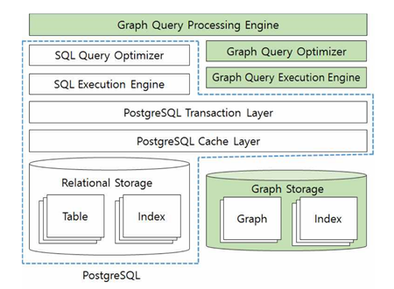
PostgreSQL in Korea
4. What we are doing by using PG
Agens Graph
Multi model database based on PG
Relational database
Document store
Graph database
Native graph storage
Efficient graph traversing
Novel graph index structure
ACID transaction based on PG’s MVCC
Why we develop a graph database on relational database?
Robust reliability
Mature features and external tools
Benefits of multi model database ← Polyglot persistency
11

Slide 14
PostgreSQL in Korea
4. What we are doing by using PG
Agens Graph roadmap
2016 3Q
2017 3Q
2018 3Q
Release a first graph database in Korea
Convenient client library
Supports Cypher query
RDBMS + Doc.Store + Graph Store
Agens Graph v1.0
Please join us! We are hiring!
Distributed cluster graph database
Graph analysis framework
Improvement query optimization
Integrates SQL and Cypher query
Agens Graph v2.0
Loads SSD
Big data analysis system to process tens of billions of edge
Apply to various use cases
Agens Graph v3.0
12

Slide 15
Presenter
Name :
Hyungjoo Lee
E-mail :
leehj@bitnine.net
Phone :
+82-10-3307-0121
Korea
Head office is in Seoul
R&D center is in Incheon
U.S.
Head office is in San Jose, CA
R&D center is in Santa Clara, CA

